Slide 1
Capstone Project :
Bike sharing demand prediction
Team Members :
Prasad Patil
[Email: [prasadpatila99@gmail.com ]
[Github: [https://github.com/prasadpatil1999/prasadpatil1Bike-Sharing-Demand-Prediction]
Prasad Deore
[Email: [prasaddeore07@gmail.com ]
[Github:[https://github.com/prasaddeore007/Bike_Sharing_Demand_Prediction]
Kiran Wagh
[Email: [patlanchagopal119@gmail.com ]
[Github: [https://github.com/Kiran2611/Bike-Sharing-Demand-Prediction]

Slide 2
CONTENT
BUSINESS UNDERSTANDING
DATA SUMMARY
FEATURE ANALYSIS
EXPLORATORY DATA ANALYSIS
DATA PREPROCESSING
IMPLEMENTING ALGORITHMS
CHALLENGES
CONCLUSIONS

Slide 3
BUSINESS UNDERSTANDING
Bike rentals have became a popular service in recent years and it seems people are using it more often. With relatively cheaper rates and ease of pick up and drop at own convenience is what making this business thrive.
Mostly used by people having no personal vehicles and also to avoid congested public transport which that’s why they prefer rental bikes.
Therefore, the business to strive and proﬁt more, it has to be always ready and supply no. of bikes at different locations, to fulﬁl the demand.
Our project goal is a pre planned set of bike count values that can be a handy solution to meet all demands.

Slide 4
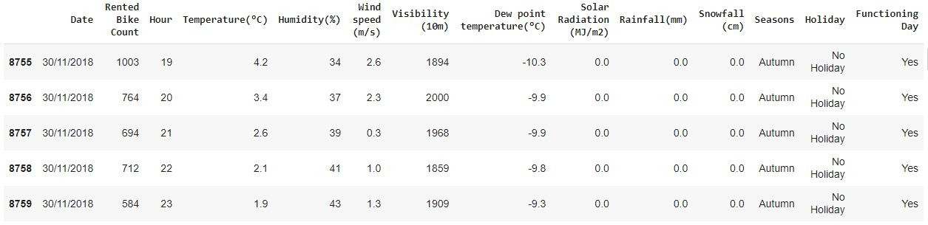
DATA SUMMARY
This Dataset contains 8760 lines and 14 columns.
Three categorical features ‘Seasons’, ‘Holiday’, & ‘Functioning Day’.
One Datetime features ‘Date’.
We have some numerical type variables such as temperature, humidity, wind, visibility, dew point temp, solar radiation, rainfall, snowfall which tells the environment conditions at that particular hour of the day.

Slide 5
FEATURE SUMMARY
Date : Year-Month-Day
Rented Bike Count - Count of bikes rented at each hour
Hour - Hour of the day
Temperature - Temperature in Celsius
Humidity - %
Wind Speed - m/s
Visibility - 10m
Dew point temperature -Celsius
Solar radiation -MJ/m2
Rainfall -mm
Snowfall -cm
Seasons -Winter, Spring, Summer, Autumn
Holiday -Holiday/No Holiday
Functional Day - NoFunc(Non Functional Hrs),Fun(Functional Hrs)

Slide 6
INSIGHTS FROM OUR DATASET
There are No Missing Values present
There are No Duplicate values present
There are No null values.
And ﬁnally we have 'rented bike count' variable which we need to predict for new observations
The dataset shows hourly rental data for one year (1 December 2017 to 31 November(2018)(365 days).we consider this as a single year data
So we convert the "date" column into 3 different column i.e "year","month","day".
We change the name of some features for our convenience , they are as below 'Rented_Bike_Count', 'Hour', 'Temperature', 'Humidity', 'Wind_speed', 'Visibility', ‘Dew_point_temperature', 'Solar_Radiation', 'Rainfall', 'Snowfall', 'Seasons', 'Holiday', 'Functioning_Day', 'month','weekdays_weekend'

Slide 7
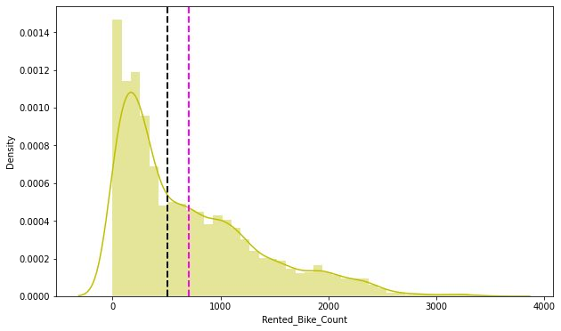
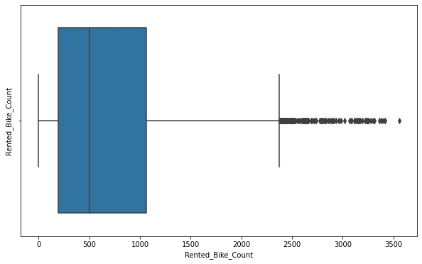
ANALYSIS OF RENTED BIKE COLUMN
The above graph shows that Rented Bike Count has moderate right skewness.
The above boxplot shows that we have detect outliers in Rented Bike Count column
Since the assumption of linear regression is that 'the distribution of dependent variable has to be normal', so we should perform Square root operation to make it normal

Slide 8
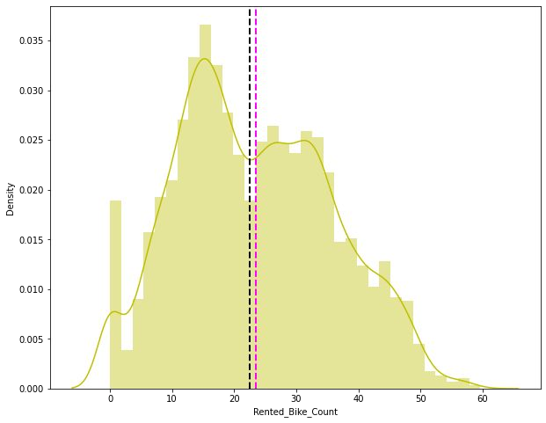
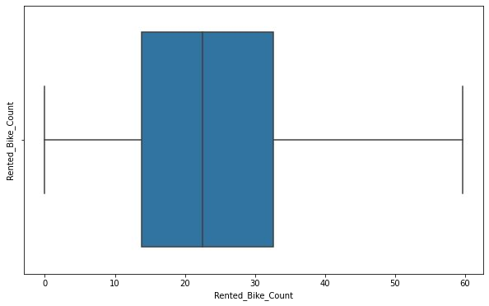
ANALYSIS OF RENTED BIKE COLUMN
After applying Square root to the skewed Rented Bike Count, here we get almost normal distribution.
After applying Square root to the Rented Bike Count column, we ﬁnd that there is no outliers present

Slide 9
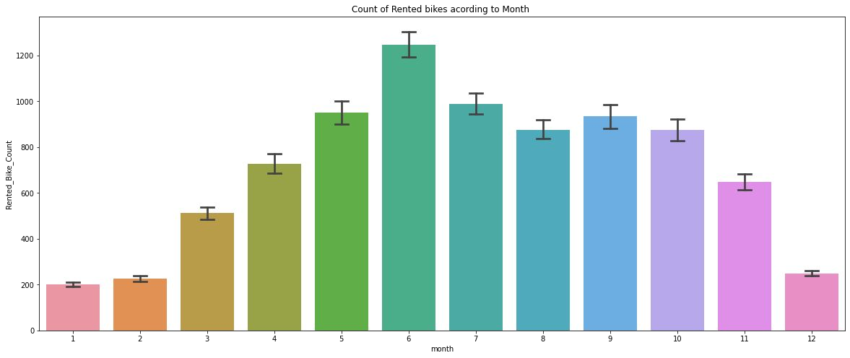
ANALYSIS OF MONTH VARIABLE
From the above bar plot we can clearly say that from the month 5 to 10 the demand of the rented bike is high as compare to other months.these months are comes inside the summer season.

Slide 10
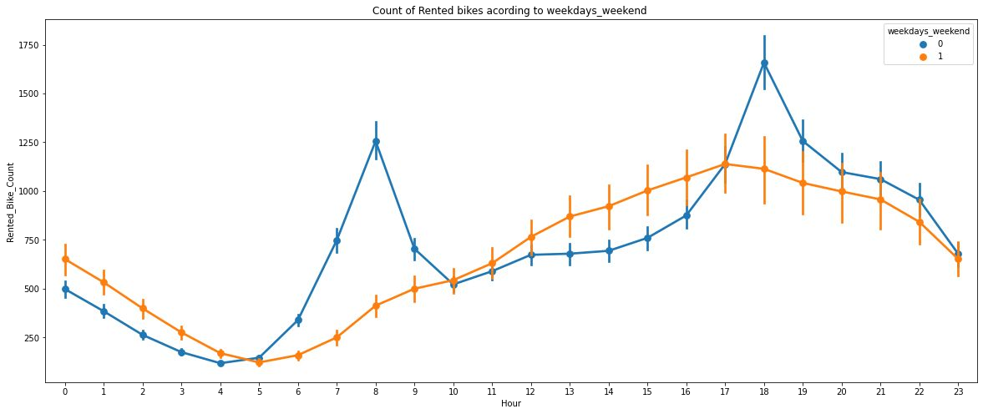
ANALYSIS OF WEEKDAYS_WEEKEND VARIABLE
From the above point plot and bar plot we can say that in the weekdays which represent in blue colour show that the demand of the bike higher because of the ofﬁce.
Peak Time are 7 am to 9 am and 5 pm to 7 pm
The orange color represent the weekend days, and it show that the demand of rented bikes are very low especially in the morning hour but when the evening start from 4 pm to 8 pm the demand slightly increases.

Slide 11
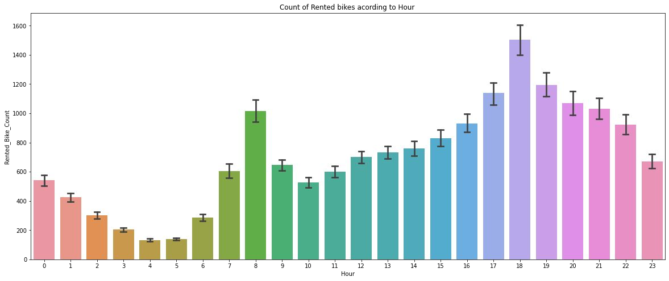
ANALYSIS OF HOUR VARIABLE
In the above plot which shows the use of rented bike according the hours and the data are from all over the year.
generally people use rented bikes during their working hour from 7am to 9am and 5pm to 7pm.

Slide 12
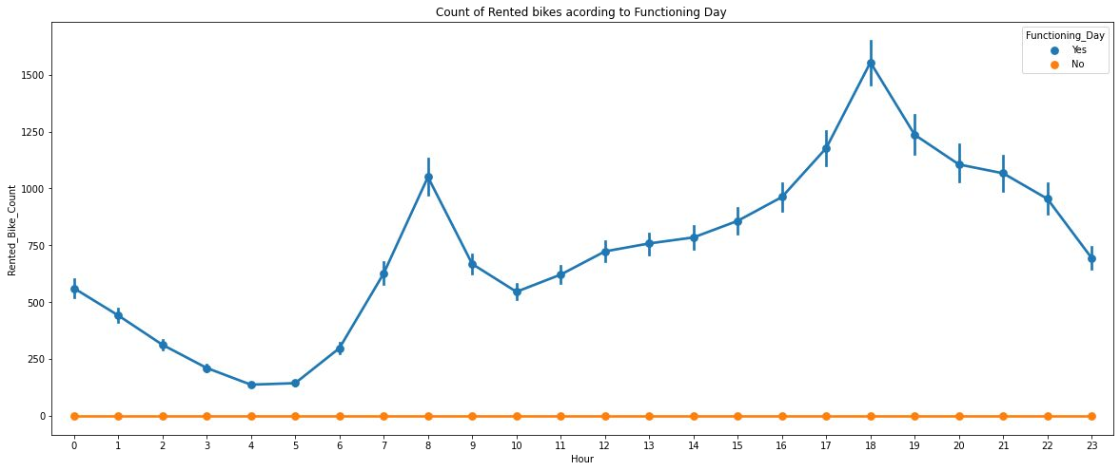
ANALYSIS OF FUNCTIONING DAY VARIABLE
In the above point plot which shows the use of rented bike in functioning daya or not, and it clearly shows that,
Peoples dont use rented bikes in no functioning day.

Slide 13
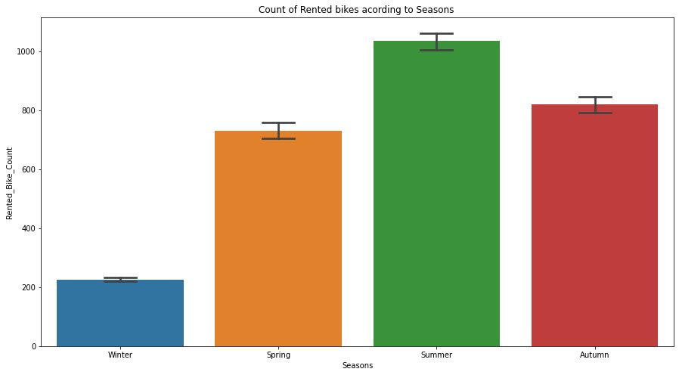
ANALYSIS OF SEASON VARIABLE
This above bar plot shows the distribution of rented bike count season wise
And we can clearly see that that peoples love to ride bike in summer seasons and autumn season
But in winter season people don't take any rented bike due to because of snowfall

Slide 14
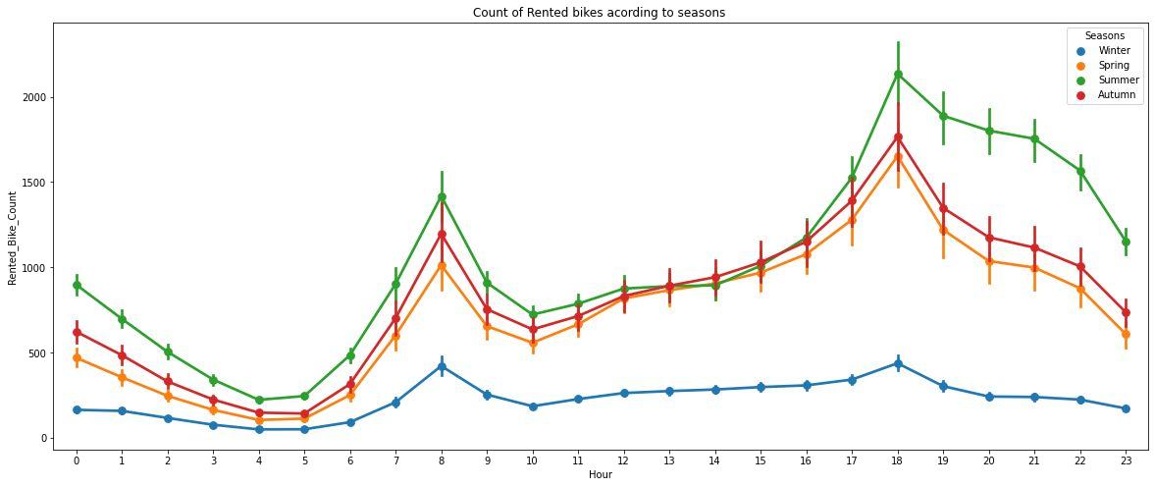
ANALYSIS OF SEASON VARIABLE
In the above bar plot and point plot which shows the use of rented bike in in four different seasons, and it clearly shows that,
In summer season the use of rented bike is high and peak time is 7am-9am and 7pm-5pm.
In winter season the use of rented bike is very low because of snowfall

Slide 15
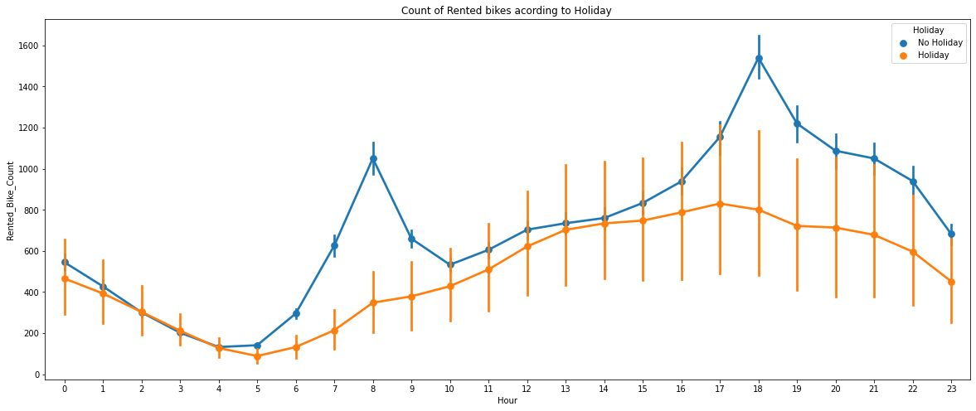
ANALYSIS OF HOLIDAY VARIABLE
In the above bar plot and point plot which shows the use of rented bike in a holiday, and it clearly shows that,
plot shows that in holiday people uses the rented bike from 2pm-8pm

Slide 16
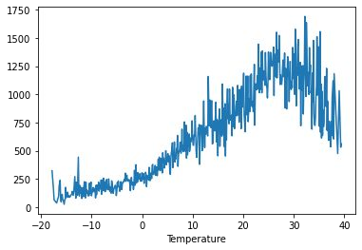
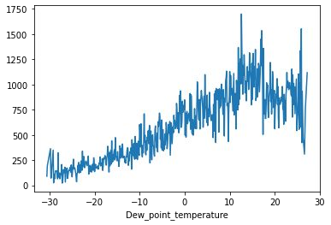
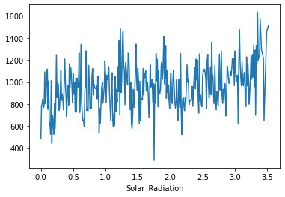
NUMERICAL VS.RENTED BIKE COUNT
From the above plot we see that people like to ride bikes when it is pretty hot around 25°C in average
From the above plot of "Dew_point_temperature' is almost same as the 'temperature' there is some similarity present we can check it in our next step
from the above plot we see that, the amount of rented bikes is huge, when there is solar radiation, the counter of rents is around 1000

Slide 17
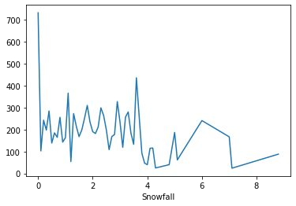
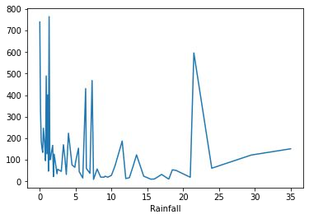
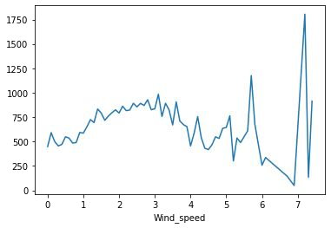
NUMERICAL VS.RENTED BIKE COUNT
In snowfall plot, on the y-axis, the amount of rented bike is very low When we have more than 4 cm of snow, the bike rents is much lower
In rainfall plot if it rains a lot the demand of of rent bikes is not decreasing, here for example even if we have 20 mm of rain there is a big peak of rented bikes
In wind speed plot that the demand of rented bike is uniformly distribute despite of wind speed but when the speed of wind was 7 m/s then the demand of bike also increase that clearly means peoples love to ride bikes when its little windy

Slide 18
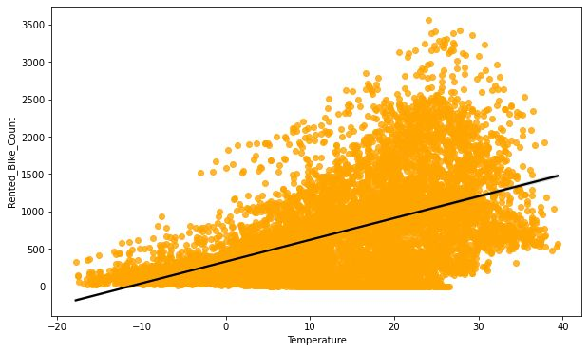
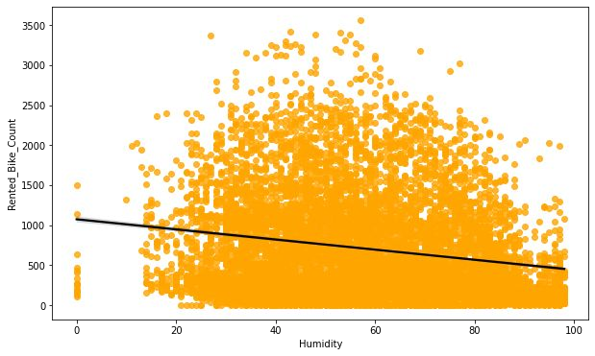
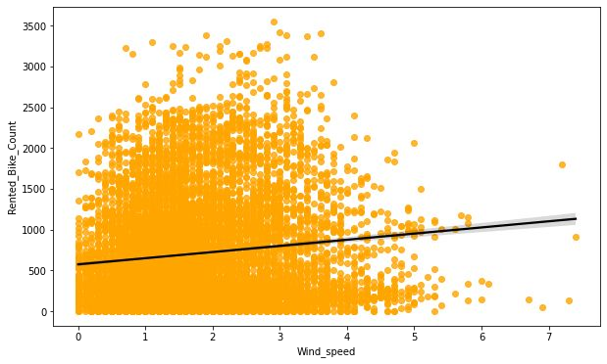
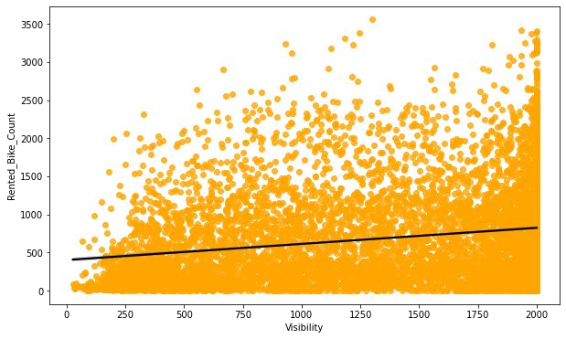
REGRESSION PLOT FOR NUMERICAL VARIABLE

Slide 19
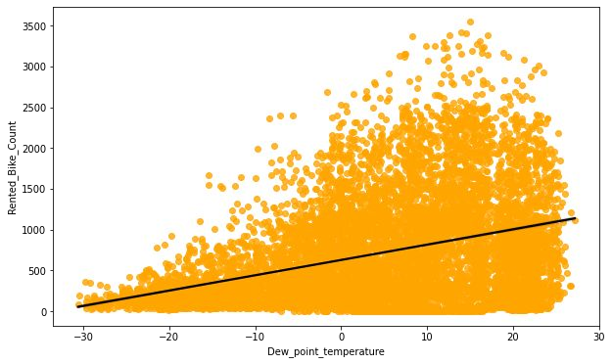
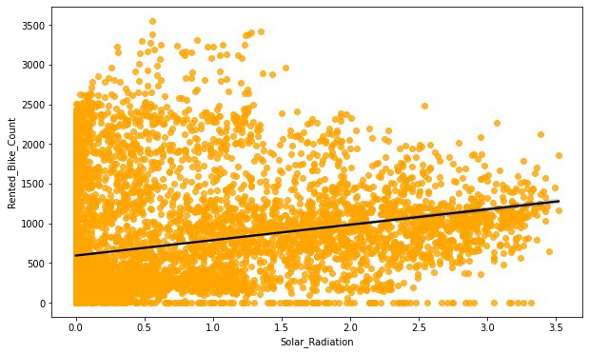
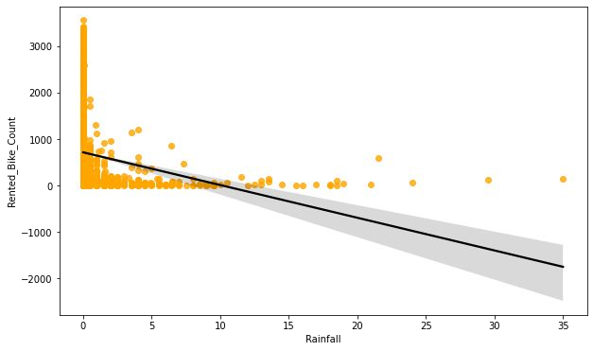
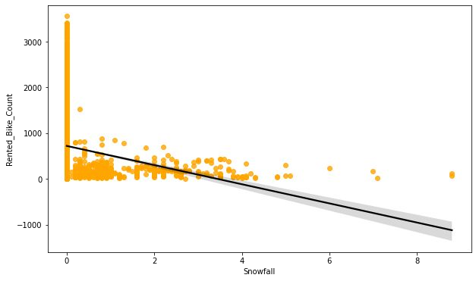
REGRESSION PLOT FOR NUMERICAL VARIABLE

Slide 20
REGRESSION PLOT FOR NUMERICAL VARIABLE
From the above regression plot of all numerical features we see that the columns 'Temperature', 'Wind_speed','Visibility', 'Dew_point_temperature', 'Solar_Radiation' are positively relation to the target variable.
which means the rented bike count increases with increase of these features.
'Rainfall','Snowfall','Humidity' these features are negatively related with the target variable which means the rented bike count decreases when these features increase.

Slide 21
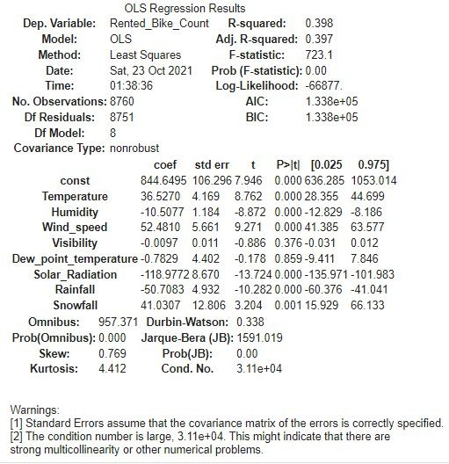
OLS REGRESSION MODEL
R square and Adj Square are near to each other. 40% of variance in the Rented Bike count is explained by the model.
P value of dew point temp and visibility are very high and they are not signiﬁcant.

Slide 22
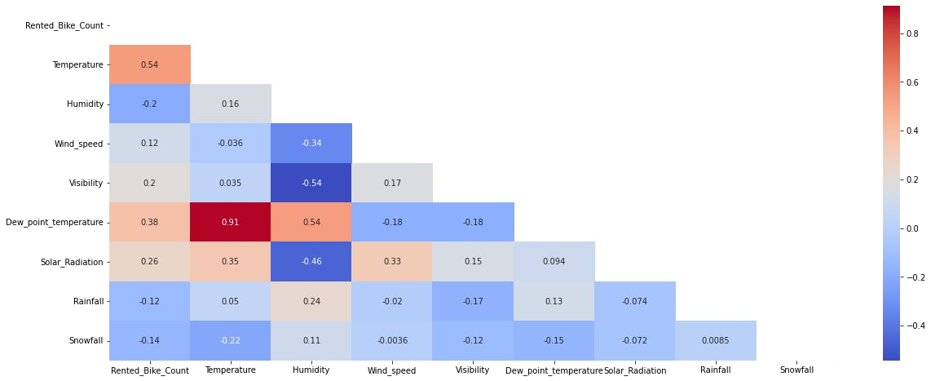
CORRELATION MATRIX
Variables like Dew Point Temperature, and Temperature are highly correlated.

Slide 23
MODEL BUILDING
LINEAR REGRESSION
LASSO REGRESSION
RIDGE REGRESSION
DECISION TREES REGRESSOR
RANDOM FOREST REGRESSOR
GRADIENT BOOSTED REGRESSOR
GRADIENT BOOSTING REGRESSOR WITH GRIDSEARCHCV

Slide 24




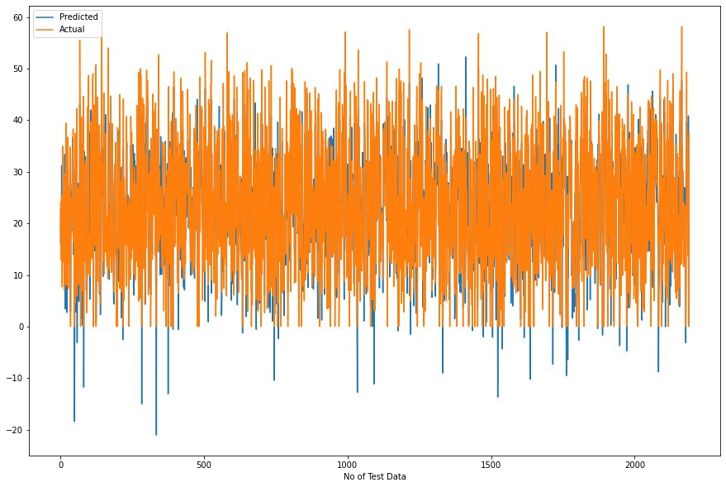
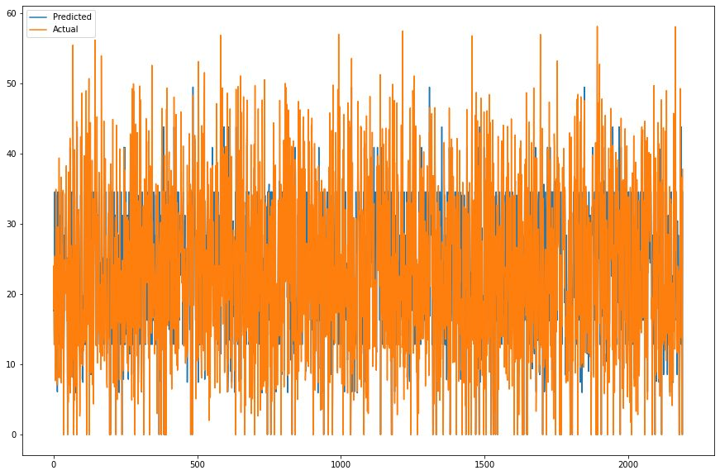
LINEAR REGRESSION
DECISION TREE
Train Set Results
Test Set Results
Train Set Results
Test Set Results

Slide 25






LASSO REGRESSION
RIDGE REGRESSION
ELASTIC NET REGRESSION
Train Set Results
Train Set Results
Train Set Results
Test Set Results
Test Set Results
Test Set Results

Slide 26
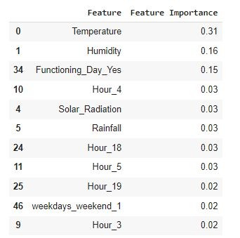
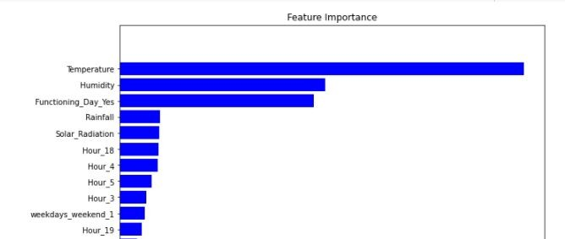


RANDOM FOREST
Train Set Results
Test Set Results

Slide 27

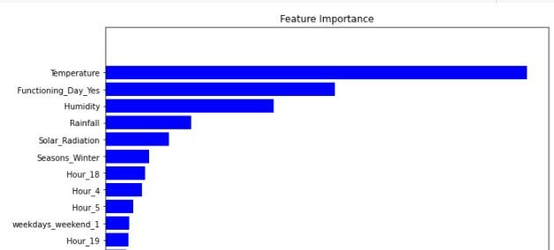

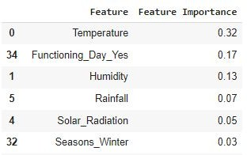
GRADIENT BOOSTING
Train Set Results
Test Set Results

Slide 28
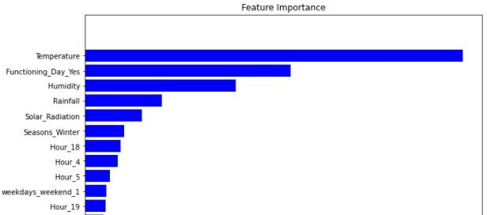


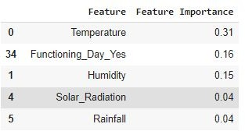

GRADIENT BOOSTING REGRESSOR WITH GRIDSEARCHCV
Train Set Results
Test Set Results
Hyper parameter

Slide 29
CHALLENGES
Large Dataset to handle.
Needs to plot lot of Graphs to analyse.
Feature engineering
Feature selection
Optimising the model
Carefully tuned Hyperparameters as it affects the R2 score.

Slide 30
CONCLUSION
‘Hour’ of the day holds the most important feature.
Bike rental count is mostly correlated with the time of the day as it is peak at 10 am morning and 8 pm at evening.
We observed that bike rental count is high during working days than non working day.
We see that people generally prefer to bike at moderate to high temperatures, and when little windy
It is observed that highest number bike rentals counts in Autumn & Summer seasons & the lowest in winter season. We observed that the highest number of bike rentals on a clear day and the lowest on a snowy or rainy day. We observed that with increasing humidity, the number of bike rental counts decreases.

Slide 31
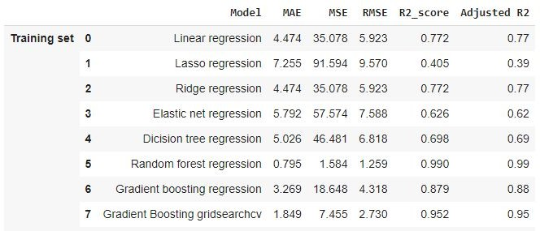
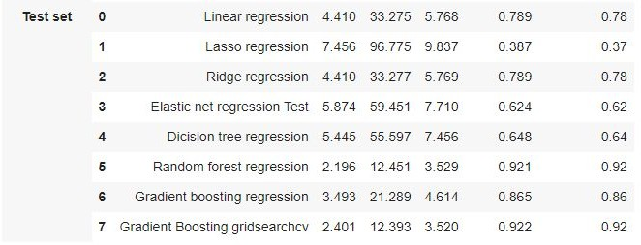
CONCLUSION
When we compare the root mean squared error and mean absolute error of all the models, Random forest Regressor and Gradient Boosting gridsearchcv gives the highest R2 score of 99% and 95% respectively for Train Set and 92% for Test set. So, ﬁnally this model is best for predicting the bike rental count on daily basis.

Slide 32
Q & A

Slide 33
THANK YOU

